Slide 1




LifeWave Compliance
Compliance
Training
AUSTRALIA
01

Slide 2

LifeWave Compliance
Compliance Training for Brand Partners
• Protecting the LifeWave reputation and the opportunity for you to build a business by following Australian advertising laws
02
Notes:
Facilitator Note: Compliance is a shared responsibility.
Speaker Notes:
Welcome, everyone! Thank you for being here today.
This session is all about protecting what we’ve built together — the reputation of LifeWave and your opportunity to grow a thriving business.
By understanding and following Australian regulations, we’re not just staying compliant, we’re building trust with customers and ensuring the longevity of this opportunity. Think of compliance as teamwork: when we all stay aligned, we all win.

Slide 3

LifeWave Compliance
Why Compliance Matters
  As a LifeWave Brand Partner, you play a vital role in how our products are presented to Customers. To protect you, our community, and the LifeWave brand, it’s essential that all product information shared in Australia follows:
  · LifeWave’s approved product claims
  · Australia’s Therapeutic Goods Advertising Code (TGA guidelines)
  This ensures that everything you say is accurate, compliant, and consistent, helping you build trust and long-term success.
03
Notes:
Speaker Notes:
As a LifeWave Brand Partner, you’re at the front line of how our products are shared with customers. To protect you, our community, and the LifeWave brand, it’s important that all product information in Australia follows two key standards:
LifeWave’s approved product claims
Australia’s Therapeutic Goods Advertising Code, or TGA guidelines
By following these, you make sure everything you share is accurate, compliant, and consistent—helping you earn customer trust and build long-term success.

Slide 4

LifeWave Compliance
Why Compliance Matters
  TGA regulates therapeutic goods
  ACCC enforces consumer protection and misleading claims
  LifeWave patches are classified as general commodity products
  Stay aligned with regulations by promoting LifeWave products only within the ‘general commodity’ category
03
Notes:
Speaker Notes:
Here’s the simple breakdown:
- The Therapeutic Goods Administration (TGA) looks after products that claim to treat, prevent, or alter biological functions.
- The Australian Competition & Consumer Commission (ACCC) ensures that advertising is not misleading and that all claims are backed up.
Our products are proudly classified as general commodities— which is fantastic because it means they’re easier to share! That means we can talk about them in everyday, lifestyle-focused ways. But if we drift into “therapeutic” or “performance” claims — such as saying they heal, treat, or boost stamina — then regulators may see them as medical devices. That’s a line we don’t want to cross. Staying in the general commodity lane keeps us safe and credible.

Slide 5


LifeWave Compliance
Marketing vs. TGA Approval
• Claims dictate classification, not product form
• Therapeutic claims may classify products as medical devices
• LifeWave patches are not registered as a medical device in Australia
• Keep us safe, use general commodity terms when marketing LifeWave products
05
Notes:
Speaker Notes:
It’s important to remember: it’s not the product itself, but how we talk about it that matters.
Our patches are marketed as non-invasive, wearable technology. But if we suggest they change the body’s biological function, the TGA could step in and reclassify them. To protect everyone’s business, let’s keep our marketing language within the “general commodity” category.

Slide 6


LifeWave Compliance
General Commodity Vs. Therapeutic Claims
Allowed (General Commodity):
Not Allowed (Therapeutic/Performance):
• Designed for those with active lifestyles
• Use as part of your evening routine
• Non-Specific Statements
• Treats, prevents, cures any disease or body function
• Any performance claim (e.g. improves stamina)
08
Notes:
Speaker Notes:
Think of general commodity claims as painting a lifestyle picture — easy, safe, and relatable. Phrases like 'Designed for those with active lifestyles' or 'Use as part of your daily ritual' invite customers in without crossing any lines.
On the other hand, therapeutic or performance claims suggest medical outcomes. These not only break the rules but also put your business at risk.

Slide 7

LifeWave Compliance
Examples of Acceptable Language
Acceptable
Avoid
• Use as part of your daily ritual
• Reflects your body’s natural infrared heat
• Non-invasive and easy to apply
• Wearable technology
• Heals, Treats, Prevents, Reduces pain
• Boosts immunity, Increases stamina
• Stem Cell activation
06
Notes:
Speaker Notes:
The best way to think of compliance-friendly language is: focus on lifestyle and technology.
Words like 'heals' or 'boosts immunity' sound powerful, but they put you into TGA/ACCC territory. Instead, lean into words like 'ritual,' 'routine,' and 'wearable innovation.' These words are still engaging but safe.
Here are some “green light” examples you can confidently use:
• Use as part of your daily ritual
• Reflects your body’s natural infrared heat
• Non-invasive and easy to apply
• Wearable technology
And here are some “red light” words to never use: heals, treats, reduces pain, or anything about boosting immunity or altering stem cells.
If you ever wonder if a phrase is okay, stick to the safe, lifestyle-focused side — or just ask compliance.

Slide 8

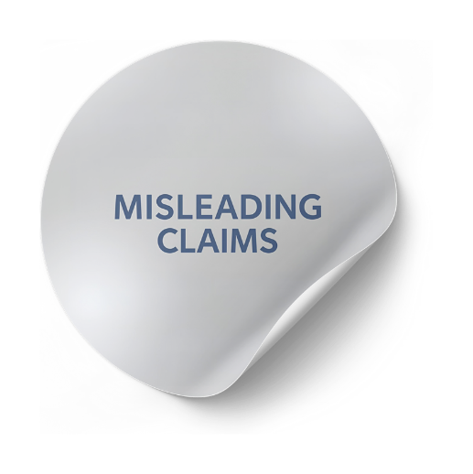

LifeWave Compliance
Misleading and Performance Claims
• ACCC Risk: Unsubstantiated or exaggerated claims can be misleading
• TGA Risk: Unapproved therapeutic claims can lead to penalties
• Use only marketing materials and claims approved for Australia
07
Notes:
Speaker Notes:
Both regulators take claims seriously:
- The ACCC acts against unsubstantiated or exaggerated claims.
- The TGA can penalize unapproved therapeutic claims.
Good news? LifeWave provides ready-to-use marketing resources.
The safest way forward is simple: use only approved marketing materials and language. This protects your business and keeps our brand strong.

Slide 9

LifeWave Compliance
Brand Partner Responsibilities
• Do NOT make performance or therapeutic claims on social media, websites, online or in print
• Stick to approved phrases and imagery
•Each country has its own regulations, please do not assume claims made in other countries are approved for Australia
•Do Not copy and paste materials that may be safe in other countries, as it may be a violation of Australian regulatory compliance
• When in doubt, ask compliance first
05
Notes:
Speaker Notes:
As a brand partner, you’re the face of LifeWave. To keep your business safe:
- Never make therapeutic or performance claims.
- Stick to approved phrases and imagery
- Don’t copy materials from other countries — what’s safe in the US or Europe may be a violation here.
And remember, you’re not alone: if you’re ever unsure, compliance is here to help.

Slide 10

LifeWave Compliance
Call To Action
• Remove all therapeutic and performance claims immediately
• Position products only as general commodity items
05
Notes:
Speaker Notes:
This is your action step: review your materials, remove anything that looks like a therapeutic or performance claim, and reframe everything within general commodity language.
Our products are amazing lifestyle tools, and that’s exactly how we should share them. This protects your business, protects our company, and builds long-term trust with customers.

Slide 11



LifeWave Compliance
Next Steps & Support
Compliance Resources:
• E-Mail: Compliance@lifewave.com
Q&A or Help:
• Contact compliance@lifewave.com for guidance.
www.lifewave.com
compliance@lifewave.com
09
Notes:
Speaker Notes:
We’re here to support you every step of the way. Save the compliance email in your contacts so you can always reach out with questions.
Thank you for partnering with us to keep LifeWave strong, trusted, and compliant. Together, we’re building a business that lasts.

Slide 12


LifeWave Compliance
Thank You
10
Notes:
Thank you!

